Slide 1


Golem Network Provider Node - Windows Subsystem for Linux
Deployment Presentation
Adam Mayfield
18 April, 2021
Github - https://github.com/r34x/
Reddit - /u/r4x
Discord - r4x#2916
Email – amayfield1979@gmail.com

Slide 2
Purpose
The reason behind this install is to help standardize installations across the network to known-good states. This will aid in troubleshooting nodes and resolving bugs. In addition, this is built for users that use Windows 10 instead of Linux as their primary operating system.

Slide 3
Objective
The objective is to get the Golem Provider installed on Windows Subsystem for Linux. This will ease the barrier to entry, as there are only a few simple Linux tasks to run once nested virtualization is enabled.

Slide 4
Prerequisites
You MUST be using Windows 10 Insider Preview Dev channel Build 21354.1
AND
Windows Subsystem for Linux Update 5.4.72

Slide 5
Instructions
Download the Windows 10 Dev Channel Build 21354 https://drive.google.com/file/d/1rKIihZ2EgC8_DfVlWRHsg6OMdHt-fDjl/view?usp=sharing
2) Install as normal. Recommend a VM, but can be installed on a physical machine.
3) Make sure all virtualization features are turned on for your environment.
4) Download and install the Windows Subsystem for Linux Update 5.4.72 (https://wslstorestorage.blob.core.windows.net/wslblob/wsl_update_x64.msi)
5) Reboot the machine
6) Open Powershell as Administrator and type the following: wsl --set-default-version 2
7) Open the Windows Store and search for Ubuntu 20.04. Download and install.
8) Launch when installation is complete. You should see a $ prompt
9) Enter uname -a to verify the kernel. Should report 5.4.72-microsoft-standard-WSL2
10) Enter sudo apt update && sudo apt full-upgrade && sudo apt install cpu-checker && sudo apt install acl
11) Enter sudo kvm-ok
a. You should see the following: INFO: /dev/kvm exists. KVM acceleration can be used.

Slide 6
Instructions
12) If you get a message that /dev/kvm does not exist, enter the following commands:
a. curl -o setup-kvm.sh https://join.golem.network/setup-kvm.sh
b. sudo chmod +x ./setup-kvm.sh
c. ./setup-kvm.sh
13) Download the Golem Provider installation script at https://github.com/r34x/Automatic-Golem to setup your Golem Provider.

Slide 7
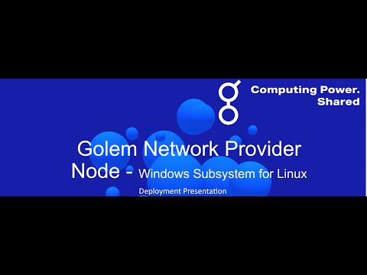
Demo Walkthrough.

Slide 8
Monitoring Your Provider
I’ve added some nice features for monitoring your system and Golem Provider.
A Netdata install is included that allows you to monitor every aspect of your machine. More info about Netdata is available on their site
https://www.netdata.cloud/
Once WSL is set up and configured, you can run “watch -c golemsp status”. This will monitor the process and refresh the screen every 2 seconds by default.

Slide 9
Conclusion
This project was a lot of fun to work on and I hope it helps you become a better provider and allows you to get up to speed quickly. If you have any questions, please reach out. My contact info is on Page 1.
Thank you!

